Slide 1

A/B Testing Assignment
By: Joachim
Date: May 8 2024

Slide 2
Content
Problem Statement
Performance Metrics Identification
Data Cleaning & Preparation
Data Visualization
Distribution of Data
How should the trends be tested?
Results
Food for thought: Customers who are sensitive to VT
Conclusion & Afterthoughts
Recommendation

Slide 3
Problem Statement
Our machine learning engineers recently developed a new feature for our model that can potentially increase the number of view-through install conversions.
Glossary
Spend: the amount of money spent serving ads to users
Impressions: the number of times an ad is shown to users
Installs: the number of users who download the advertised app onto their mobile devices, installs are further identified as either click-through installs or view-through installs where:
click through install (aka CT install) = an install that was acquired after the user saw an ad and clicked on the ad
view through install (aka VT install) = an install that was acquired after the user saw an ad (did not click on the ad)
Note: that some of our customers are more sensitive than others to increases in view-through installs because these customers believe click-through installs have a higher signal of intent to engage with the app than view-through installs.
Launch/Do Not Launch?
Does the new feature will increase view-through install conversions?
Does the new feature reflect improved performance?

Slide 4
Performance Metrics Identification
Customer engages Liftoff
30 customers with 5 sensitive to VT installation
Generate impressions
User choose to install ad
User can install via VT or CT
Impressions costs customer money / spend
Metric:
Cost per impressions
(Spend/Impressions No x 1000)
Metric:
Conversion rate of installation
(Installation No/Impression No *100)
Can be broken down into VT, CT and Total
Notes:
Cost per impression formula breakdown = the spend amount divided by the number of impressions per 1000 installations

Slide 5
Data cleaning and preparation
Checked the data for completeness
Combined the 2 CSVs into a single file adding new columns for CT install no/VT install no
Computed the 4 key metrics for each row:
VT installations conversion
CT installations conversion
Total installations conversion
Cost per impressions

Slide 6
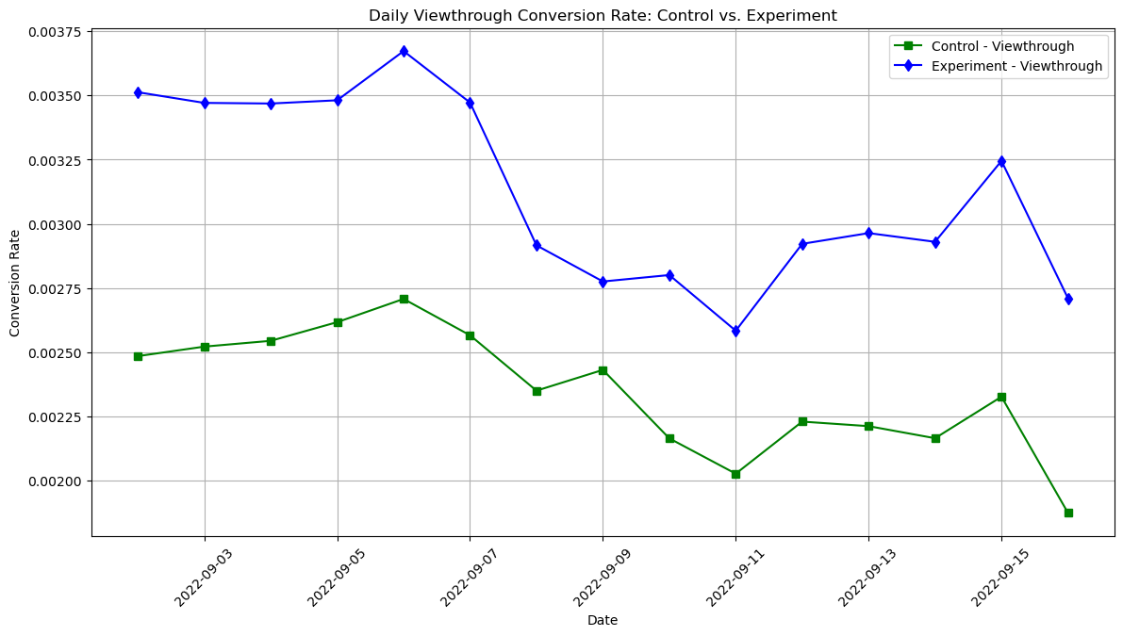
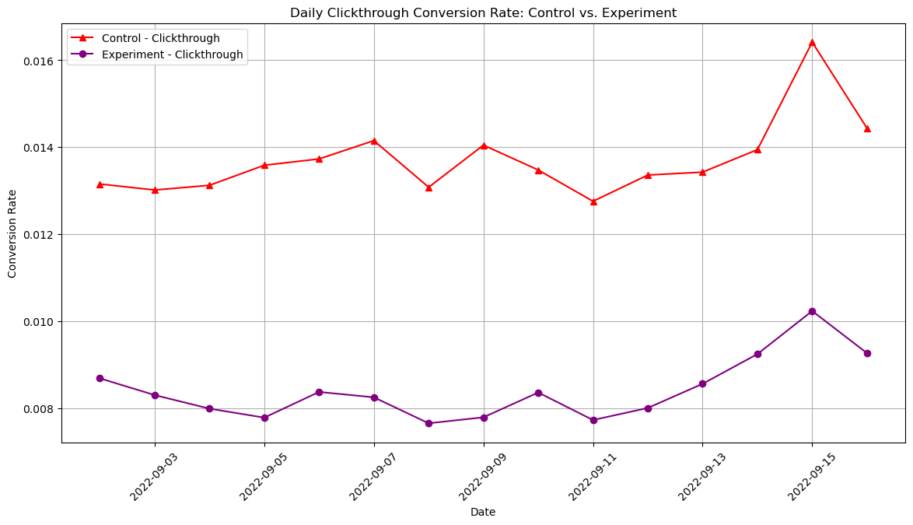


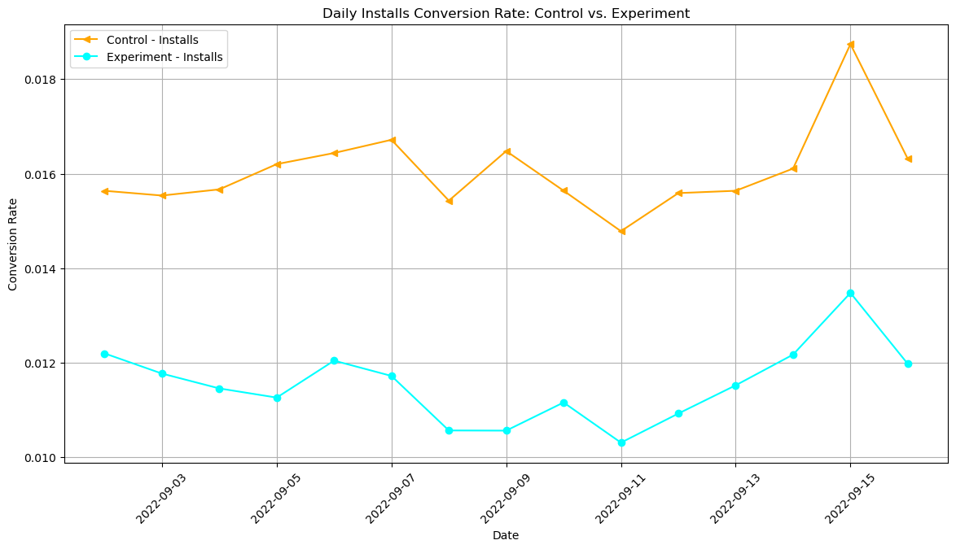
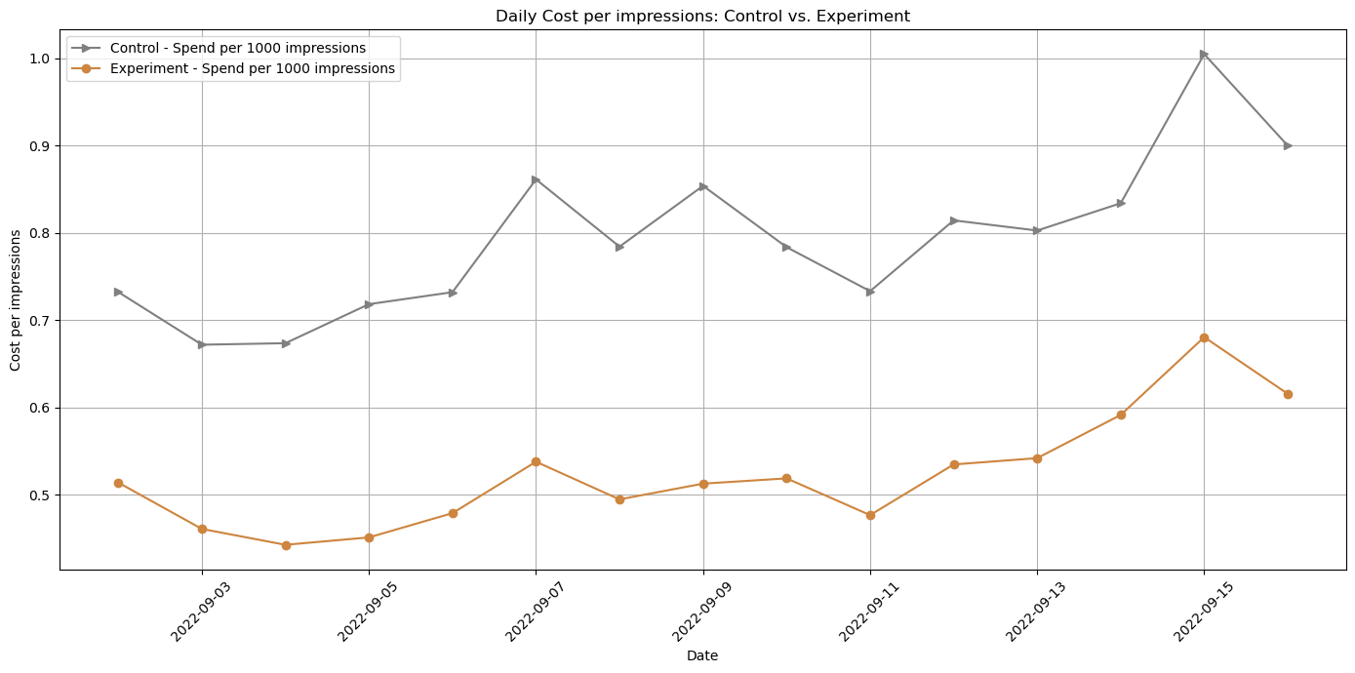
Data Visualization
Plotted out the average daily metrics for control and experiment group to identify trends to test
CT Conversion rate appears to have deteriorated with feature
VT Conversion rate appears to have improved with feature
Total conversion rate appears to have deteriorated with feature
Costs per impressions appears to have improved with feature

Slide 7
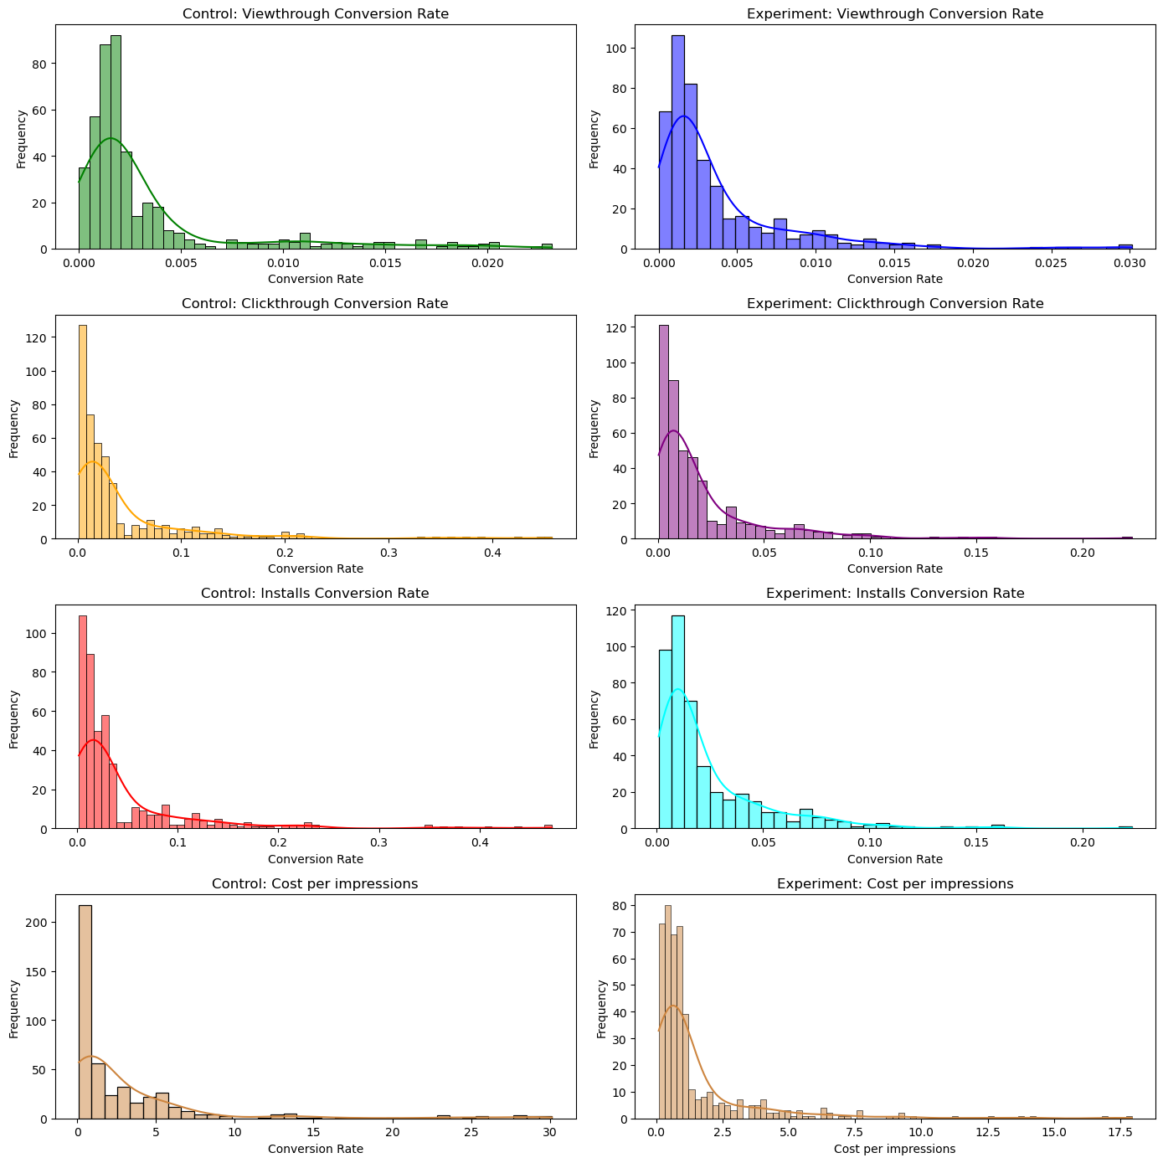
Distribution of data
Plotted out each of daily metrics for control and experiment group to ascertain distribution type
From the charts, the population for all 4 metrics appears to be right skewed
Had also run Shapiro-Wilk Test test on the 4 metrics which yield very low p-value ≈ 0.0 , confirming data is non-normality.
Perform Shapiro-Wilk Test for checking normality
Given the very low p-value ≈ 0.0 results for control vs experiment of the 4 tests, the data is non-normality. I suggest using non-parametric statistical tests (like the Wilcoxon signed-rank test for paired samples) might be more appropriate for comparing the control and experiment groups.

Slide 8
How should the trends be tested? (1/2)
Hypothesis for 4 tests based on the trends we had observed in slide 6
#1 Viewthrough conversion rate
#2 Clickthrough conversion rate
Null Hypothesis (Ho): The view-through conversion rate in the experiment group is equal to the control group.
Alternative Hypothesis (Ha): The view-through conversion rate in the experiment group is greater than the control group.
Null Hypothesis (Ho): The click-through conversion rate is equal in the experiment group compared to the control group.
Alternative Hypothesis (Ha): The click-through conversion rate is lower in the experiment group compared to the control group.
#3 Total installs conversion rate
#4 Cost per impressions
Null Hypothesis (Ho): The total conversion rate is equal in the experiment group compared to the control group.
Alternative Hypothesis (Ha): Total conversion rate is lower in the experiment group compared to the control group.
Null Hypothesis (Ho): The cost per impressions in the experiment group is equal to the control group.
Alternative Hypothesis (Ha): The cost per impressions in the experiment group is lower than the control group.

Slide 9
How should the trends be tested? (2/2)
Compare each metric between control and experiment groups for 30 customers on each of the 15 days using 1-sided Wilcoxon Signed Rank Test (non-parametric paired test)
Sample size: 450
Significance level alpha = 0.05
Confidence Interval = 0.95
Assumptions taken
The experiment was conducted under no special circumstances during the 2 week period. Eg no public holiday occurrence , no special campaigns run
The daily control/experiment performance for each customer is independently of that of other days
Effect of new feature can be recognized on same day - For VT install where an install that was acquired after the user saw an ad, the user saw and install the ad on the same day.
The occurrence of customers who are sensitive to VT is natural. Across all customer bases in the industry, 16.67% are sensitive to VT. No data points were removed.
**Food for thought**
Do customers who are sensitive to VT behave differently from rest of customer population?

Slide 10
Results
For all 4 tests, null hypothesis is rejected.
#1 Viewthrough conversion rate
#2 Clickthrough conversion rate
Mean Difference: 0.00029%, Positive
95% Confidence Interval: (-0.00029, 0.00087), interval includes zero
Test Statistic: 40592
P-value:0.0003423, less than 0.05 – reject Ho
Lift: 8.44%
This implies that the VT conversion rate is statistically significantly greater with the feature. On average, the view-through conversion rate in the experiment group is about 8.44% lower than in the control group.
Mean Difference: -0.0210% , Negative
95% Confidence Interval: (-0.0275, -0.0145), interval range is negative
Test Statistic: 81506
P-value: 3.7063e-29, less than 0.05 – reject Ho
Lift: -20.01%
This implies that the CT conversion rate is statistically significantly lower with the feature. On average, the click-through conversion rate in the experiment group is about 20.01% lower than in the control group.
#3 Total conversion rate
#4 Cost per impressions
Mean Difference: -0.0207% , Negative
95% Confidence Interval: (-0.0275, -0.0139), interval range is negative
Test Statistic: 76627
P-Value: 3.3193e-2, less than 0.05 – reject Ho
Lift: -10.79%
This implies that the total conversion rate is statistically significantly lower with the feature. On average, the total conversion rate in the experiment group is about 10.79% lower than in the control group.
Mean Difference: -$1.58, Negative
95% Confidence Interval: (-2.1013, -1.0684), interval range is negative
Test Statistic: 79071
P-Value: 5.0785e-25, less than 0.05 – reject Ho
Lift: -18.23%
This implies that the total cost per impressions is statistically significantly lower with the feature. On average, cost per impressions in the experiment group is about 18.23% lower than in the control group.
Notes:
0.26350806479852795

Slide 11
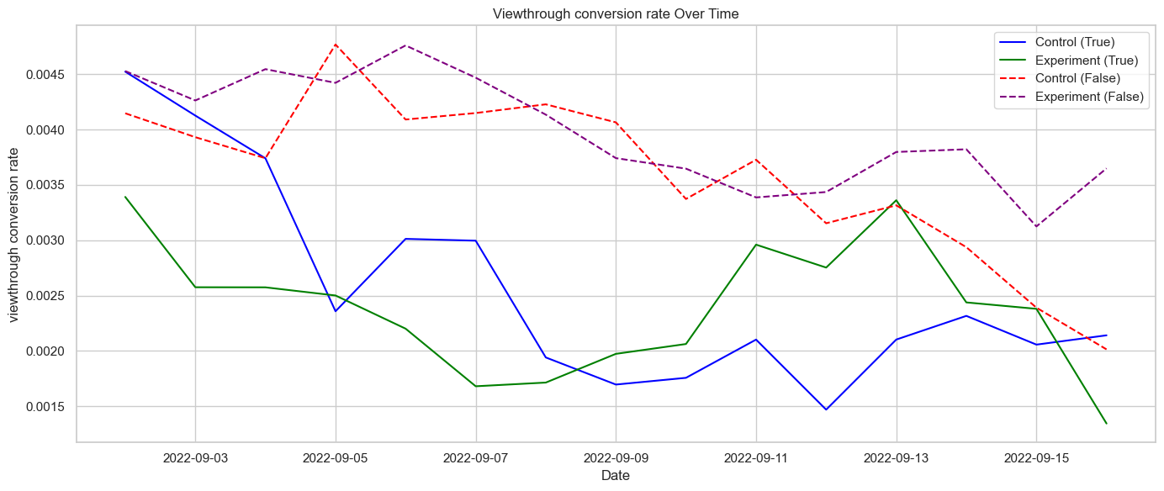
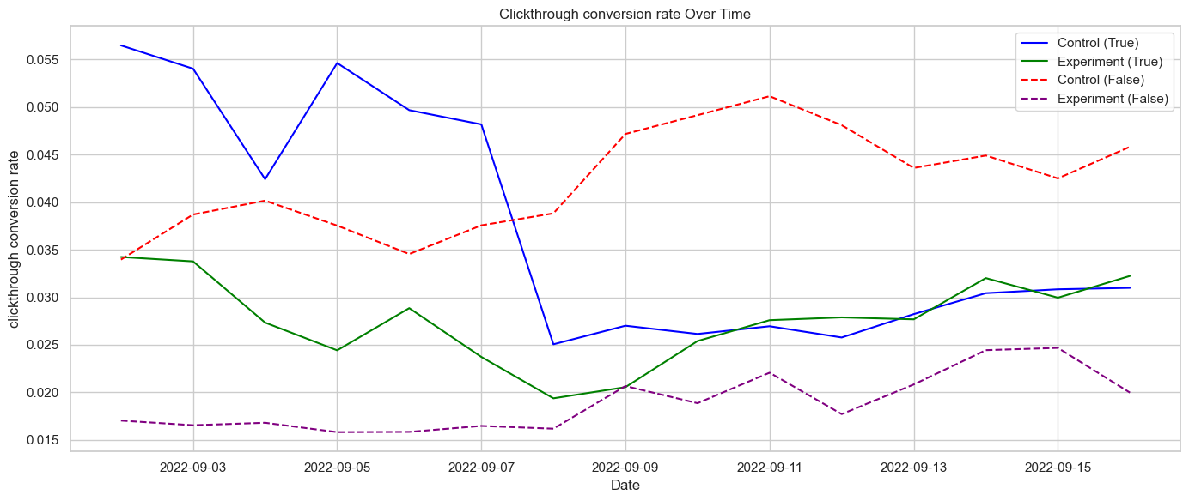
Food for thought: Do customers who are sensitive to VT behave differently from rest of customer population? (1/2)
Visualization – plot the control and experiment metrics for sensitive to VT population to not sensitive to VT population
Customers who are sensitive to VT appear to behave differently from rest of customer population
Sensitive customer have a wider difference than non sensitive customers in experiment vs control. Sensitive customers have a lower experiment VT conversion rate except during the period of 11-13 Sep
Non sensitive customers experience a consistently higher CT conversion ratio in the control vs experiment. Sensitive customers experience a higher CT conversion ratio in the control vs experiment at the start but after a week, the ratio for both control & experiment converges

Slide 12
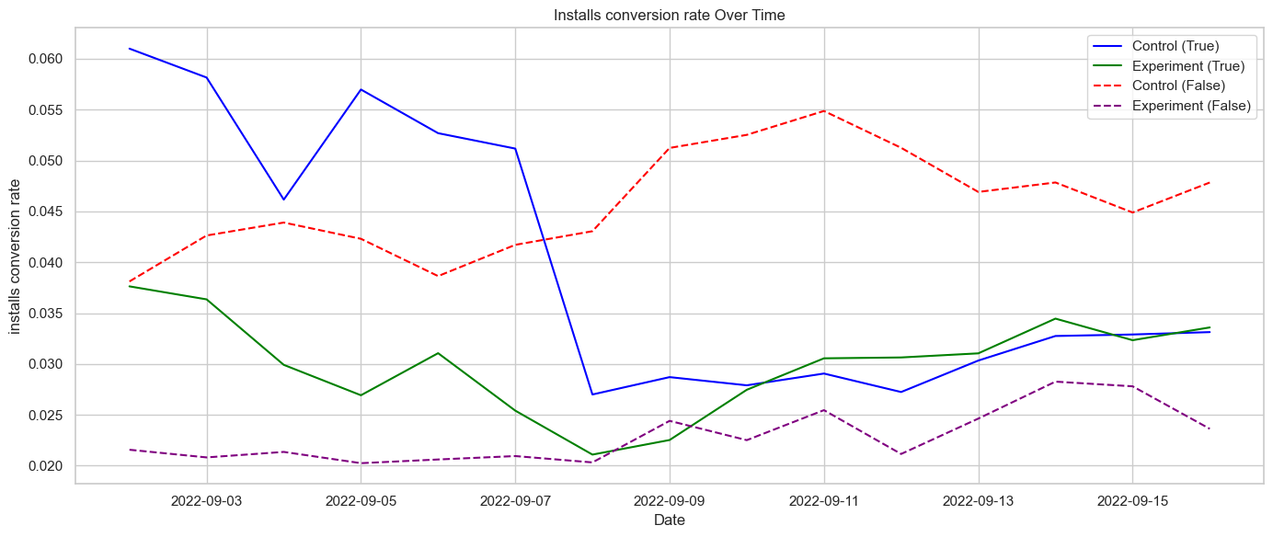
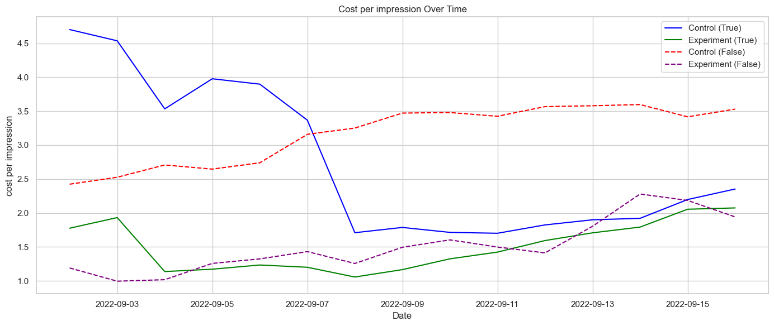
Food for thought: Do customers who are sensitive to VT behave differently from rest of customer population? (2/2)
Non sensitive customers experience a consistently higher total conversion ratio in the control vs experiment. Sensitive customers experience a higher total conversion ratio in the control vs experiment at the start but after a week, the ratio for both control & experiment converges
Cost per impression for non sensitive customers are consistently lower in the experiment.
Cost per impression for sensitive customers are lower in the experiment but this seems to converge with that of the control after a week

Slide 13
Conclusion & afterthoughts (1/3)
Our analysis has uncovered a spectrum of outcomes in alignment with our initial hypotheses. While the implementation of the new feature has yielded notable enhancements in both the view-through (VT) conversion rate (8.44%) and cost efficiency, evidenced by a reduction of (18.23%) in cost per impression, it has also been accompanied by a decline in both the click-through (CT) conversion rate by (20.01%) and the overall total conversion rate by (10.79%).
Despite these acknowledged limitations, the observed improvements in the view-through conversion rate and cost per impression, albeit accompanied by declines in the click-through and total conversion rates, suggest promising potential for the new feature.
In conclusion, the present findings do not provide sufficient justification to proceed with the feature launch. Further testing is warranted. One potential avenue for refinement involves excluding customers sensitive to VT from the dataset and conducting statistical tests anew. Should subsequent analyses demonstrate an improvement in the total installs conversion rate, I would recommend rolling out the new feature exclusively to customers insensitive to VT.

Slide 14
Conclusion & afterthoughts (2/3)
Future testing such as Customer Priorities and Investigation Improvement Strategies can be explored to determine a feature launch
To decide on feature launch, comparison of the observed lift with customer satisfaction metric can be used to established threshold levels. (ie % change in metrics which will lead to increase/decrease in customer satisfaction) – refer to below table for example
If rollout isn't feasible, we should also investigate if there is any way to further improve the positive impact and mitigate/remove the negative impact.
Example: when the new feature shouldn’t be rolled out
Example: when the new feature should be rolled out
Metrics & weightage of importance | Threshold leading to increase CSAT by 5% | Threshold leading to decrease CSAT by 5% | Based on the test results
1.Total installations conversion (40%) | 15% increase in metrics | 10% decrease in metrics | CSAT decrease
2.Cost per impressions (30%) | 15% decrease in metrics | 10% increase in metrics | CSAT improves
3.CT installations conversion (15%) | 15% increase in metrics | 10% decrease in metrics | CSAT decreases
4.VT installations conversion (15%) | 15% increase in metrics | 10% decrease in metrics | No change in CSAT
Metrics & weightage of importance | Threshold leading to increase CSAT by 5% | Threshold leading to decrease CSAT by 5% | Based on the test results
1. Cost per impressions (40%) | 15% increase in metrics | 10% decrease in metrics | CSAT increases
2. Total installations conversion (30%) | 15% decrease in metrics | 15% increase in metrics | No change in CSAT
3.CT installations conversion (15%) | 15% increase in metrics | 10% decrease in metrics | CSAT decreases
4.VT installations conversion (15%) | 15% increase in metrics | 10% decrease in metrics | No change in CSAT
Overall CSAT expected to decrease 1.25%, no launch
Overall CSAT expected to increase 1.25%, launch
Notes:
CT installations conversion
Total installations conversion
Cost per impressions

Slide 15
Conclusion & afterthoughts (3/3)
How can we make this a more robust analysis
Are there any other metrics we could have investigated with the existing dataset? Eg cost per installation, total no of impressions
Can we get more datapoints from the exercise? Eg reach (no unique users whom impressions were shown)
Will a time series analysis of the data (daily or 1st week vs 2nd week) give us useful information here?
Should we have tested for co-relation across the variables?
In our Food for Thought Analysis
Customers who are sensitive to VT appear to have behave differently from rest of customer population.
Does it make commercial sense to launch a separate product (different ML model) for such customers?
Is our assumption that customers sensitive to VT are part of the natural population justified? We can remove the bias customers for the equation and run more tests to validate this.
Notes:
CT installations conversion
Total installations conversion
Cost per impressions

Slide 16
Recommendation
For implementation, consider a selective rollout of successful elements
Focus on improvements in the view-through conversion rate and cost per impression.
Utilize customer segmentation to target less VT-sensitive groups for maximum impact.
In terms of optimization
Prioritize iterative testing to refine the feature, addressing declines in CT and total conversion rates.
Explore personalization opportunities to tailor incentives or content based on user behavior, mitigating sensitivity to VT, and enhancing user experience.

